Slide 1

Natural Language Processing
Recitation Class

Slide 2
Recap
Language Model: A system that predicts the next word
Recurrent Neural Network: A family of neural networks that:
Take sequential input of any length
Apply the same weights on each step.
Can optionally produce output on each step
• RNNs are a great way to build a LM.
• But RNNs are useful for much more!

Slide 3
RNN Uses: 1. Part-of-Speech Tagging:
RNNs can be used for part-of-speech tagging, where each word in a sentence is assigned a grammatical category (e.g., noun, verb, adjective). Here's an example:
Input Sentence: "The quick brown fox jumps over the lazy dog.”
RNNs can be trained to predict these tags based on the context of the words in a sentence.
Output Tags:
"The" - Determiner
"quick" - Adjective
"brown" - Adjective
"fox" - Noun
"jumps" - Verb
"over" - Preposition
"the" - Determiner
"lazy" - Adjective
"dog" - Noun
"." - Punctuation

Slide 4
2. Sentiment Analysis:
RNNs can be used for sentence or document classification tasks, such as sentiment analysis, where the goal is to determine the sentiment (positive, negative, neutral) of a piece of text. For example:
Input Sentence: "I loved the movie; it was so entertaining!"
Sentiment: Positive
In this case, the RNN analyzes the words in the sentence and classifies it as expressing a positive sentiment.

Slide 5
3. Text Generation:
RNNs are often used to generate text, either character by character or word by word. For instance, you can train an RNN on a dataset of Shakespearean text and use it to generate Shakespearean-style text:
Generated Text: "To be or not to be, that is the question."
The RNN, after being trained on a corpus of Shakespeare's works, can generate text that mimics his writing style.

Slide 6

Problems with RNN?

Slide 7
Problem 1: Vanishing Gradient
The vanishing gradient problem occurs when the gradients computed during backpropagation become very small as they are propagated backward through the network. As a result, the weights of the network are updated very slowly, and the network takes a long time to converge or may not converge at all.

Slide 8
Vanishing Gradient Example:
Suppose you're training a simple neural network for a binary classification task, and you're using a sigmoid activation function. During backpropagation, the gradients start to become very small, close to zero. This means the weight updates are minimal, and the network learns very slowly. For instance:
Gradient of the loss with respect to a weight: 0.0001
Updated weight: 0.5 - 0.0001 = 0.4999
As you can see, the gradient is extremely small, resulting in tiny weight updates. The network converges very slowly, and it may not effectively learn from the data.

Slide 9
Problem 2: Exploding Gradient
The exploding gradient problem occurs when the gradients become extremely large during backpropagation. This leads to very large weight updates, which can destabilize the training process and make it difficult to find good model parameters.

Slide 10
Exploding Gradient Example:
Now, consider the opposite scenario where the gradients explode and become very large. During backpropagation, the gradients grow exponentially, leading to massive weight updates. For example:
Gradient of the loss with respect to a weight: 10,000
Updated weight: 0.5 - 10,000 = -9,999.5
In this case, the gradients are so large that they cause dramatic weight updates. The network might oscillate, diverge, or fail to converge to a good solution because the weight updates are too extreme.

Slide 11
Solution to Exploding Gradient
Gradient clipping is a technique used to address the problem of exploding gradients during the training of neural networks, including recurrent neural networks (RNNs). It involves scaling the gradients when they exceed a predefined threshold.

Slide 12
Gradient Clipping Process:
Calculate Gradients: During backpropagation, gradients are computed for each parameter (weights and biases) in the network. These gradients can become very large, potentially causing numerical instability.
Compute the Gradient Norm: Calculate the norm (magnitude) of the gradients. The norm can be calculated using the L2 norm (Euclidean norm), which is the square root of the sum of the squares of individual gradient values.
Apply Clipping: If the gradient norm exceeds a predefined threshold (clip_value), the gradients are scaled down so that the norm equals the threshold. If the gradient norm is within the threshold, no scaling is applied.

Slide 13
Mathematically, gradient clipping can be expressed as follows.
if ||gradients|| > clip_value:
gradients = gradients * (clip_value / ||gradients||)
Example:
Suppose you're training a simple neural network with one weight and one gradient to illustrate gradient clipping. During backpropagation, you calculate the gradient, which is much larger than the specified clip_value:
Computed Gradient: 100
clip_value: 10
With gradient clipping, you would scale the gradient down to ensure it doesn't exceed the clip_value:
Result:
gradients = 100 * (10 / 100) = 10
So, the gradients are scaled down to 10, preventing them from exploding and destabilizing the training process.

Slide 14
Simple Example for Gradient Clipping
Imagine you're baking a cake, and you're pouring a thick, chocolatey sauce (gradients) onto the cake. You want to make sure the sauce doesn't pour too fast (exploding gradients)
Gradient Clipping is like using a special nozzle on your sauce bottle to control the flow. If the sauce is coming out too quickly or too slowly, the nozzle automatically adjusts it to a reasonable speed.
Here's how it works:
If the sauce is pouring too fast (gradients are too large), the nozzle restricts the flow to a manageable rate.
If the sauce is trickling too slowly (gradients are too small), the nozzle allows it to flow a bit faster.
vanishing gradients).

Slide 15
Solution to Vanishing Gradient: LSTM
Long Short-Term Memory (LSTM) networks are a type of recurrent neural network (RNN) architecture designed to address the vanishing gradient problem and capture long-range dependencies in sequential data

Slide 16
LSTM Structure:
LSTMs have three crucial components that help mitigate the vanishing gradient problem:
Cell State: The cell state is a memory unit that runs horizontally across the top of the LSTM. It allows information to flow easily through the network without being significantly altered, which helps in capturing long-term dependencies.
Hidden State: The hidden state acts as the network's "working memory." It can selectively read from and write to the cell state, allowing it to capture relevant information while ignoring irrelevant data.
Gates: LSTMs have three gates that regulate the flow of information: the input gate, the forget gate, and the output gate. These gates use sigmoid and tanh activation functions to control the information flow, making the network adaptive to the specific data patterns.

Slide 17
How LSTMs Solve the Vanishing Gradient Problem:
LSTMs solve the vanishing gradient problem by allowing gradients to flow more effectively through the network, preserving important information over longer sequences. This is achieved through the following mechanisms:
1. Forget Gate: The forget gate determines what information from the cell state should be thrown away or kept. It does this by using a sigmoid activation function, which can output values close to 0 (forget) or close to 1 (keep). This prevents irrelevant information from clogging up the memory and vanishing gradients caused by repeatedly multiplying with small numbers.

Slide 18
2. Input Gate: The input gate is responsible for updating the cell state with new information. It decides which values should be added to the cell state. The sigmoid function decides what to update, and the tanh function creates a vector of new candidate values. The combination of these two operations allows the network to capture relevant information while preventing the vanishing gradient problem.
3. Output Gate: The output gate controls what information is read from the cell state to generate the hidden state. The sigmoid function determines which values in the cell state are worth reading, and the tanh function scales the values to be between -1 and 1. This regulated information flow helps in retaining important information while preventing the vanishing gradient issue.

Slide 19
Example: LSTM
Imagine you're processing a long text document with an LSTM to determine the overall sentiment of the text. The document contains both positive and negative statements.
The forget gate helps the LSTM discard unimportant details in the text that are not relevant to the overall sentiment.
The input gate allows the LSTM to capture new and important information as it reads through the document.
The output gate controls which aspects of the text contribute to the final sentiment prediction.

Slide 20
GRU
Gated Recurrent Units (GRUs) are a type of recurrent neural network (RNN) architecture designed to capture and model sequential data, such as time series, text, and speech. GRUs are similar to Long Short-Term Memory (LSTM) networks but have a more streamlined architecture.

Slide 21
GRU Structure:
A GRU has two key components:
Hidden State (h_t): This is the network's memory of previous time steps and the primary output of a GRU at each time step. It carries information from past time steps and is updated at each step based on the current input and the previous hidden state.
Update Gate (z_t) and Reset Gate (r_t): These are two gates that regulate the flow of information in and out of the hidden state. The update gate (z_t) controls how much of the previous hidden state should be retained, and the reset gate (r_t) decides how much of the previous state should be ignored.

Slide 22
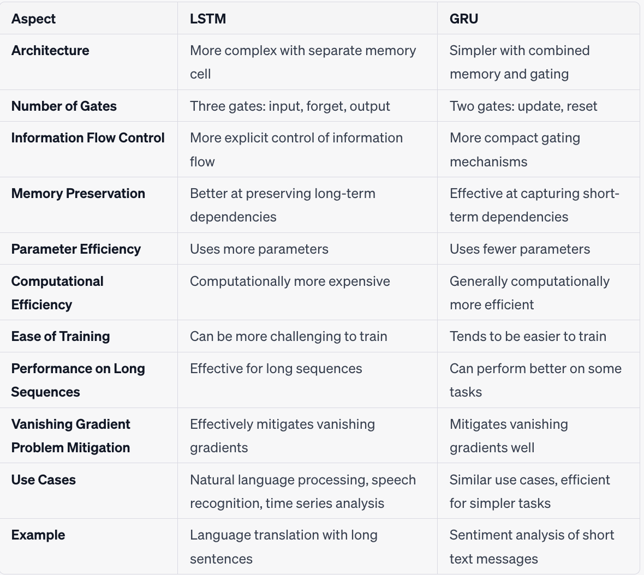

Slide 23

Thank you.

